Slide 1
Time-Wasters on Social Media
Analysis of Usage Patterns, Addiction & Productivity Loss
Presented by: Shafana Shereef
Date: 29 September 2025

Slide 2
Introduction
The "Time-Wasters on Social Media" dataset provides a detailed view of user behavior and engagement across multiple social media platforms.
Includes information on demographics, socio-economic status, device usage, platform interactions, and content engagement metrics.
Captures measures such as total time spent, session counts, video engagement, addiction levels, productivity loss, and satisfaction.
Created using synthetic data with pandas, matplotlib, and seaborn to simulate realistic usage patterns for research and analysis.
Useful for researchers, marketers, and social scientists to explore how social media affects habits, productivity, and decision-making.

Slide 3
Objectives
1. Analyze Platform-Wise Usage Patterns
Determine which social media platforms consume the most user time and identify trends across Facebook, Instagram, YouTube, and TikTok.
2. Assess Demographic Influences
Examine the impact of age, gender, and income on social media usage, addiction levels, and productivity loss.
3. Evaluate Device, OS, and Connectivity Factors
Investigate how different devices (smartphones, computers, tablets), operating systems, and connection types (Wi-Fi vs. mobile data) affect the amount of time spent on social media.
4. Study Content Engagement and Behavioral Impacts
Understand how content type, video length, addiction, self-control, and watch reasons influence engagement, productivity loss, and overall social media time-wasting behavior.

Slide 4
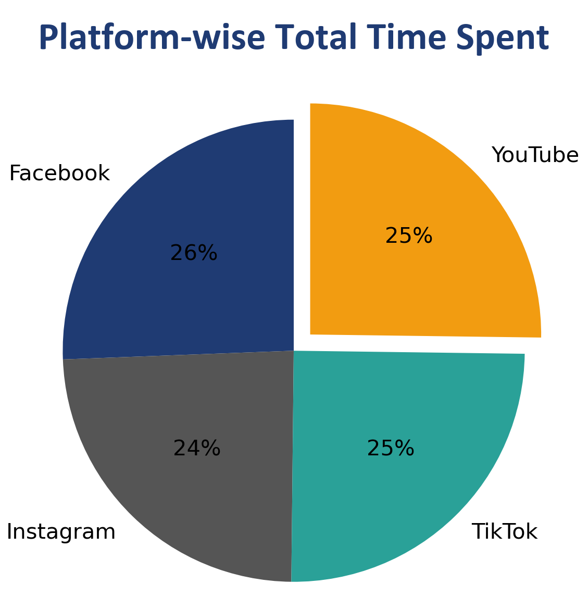
1. Platform-Wise Usage Patterns
Facebook slightly dominates (26%)
Instagram lowest (24%); YouTube & TikTok nearly equal (25%)
Usage is almost evenly distributed across all platforms
Insight: All major platforms contribute equally to time-wasting

Slide 5
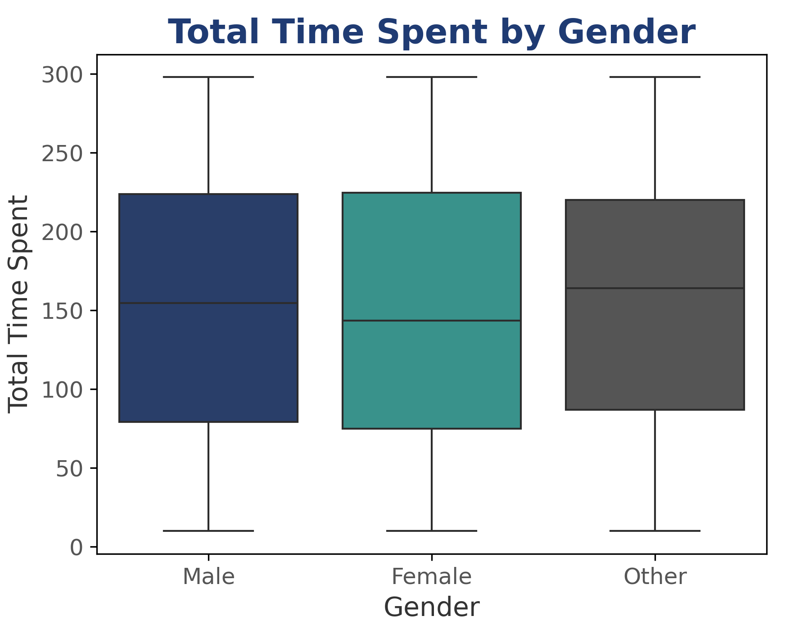
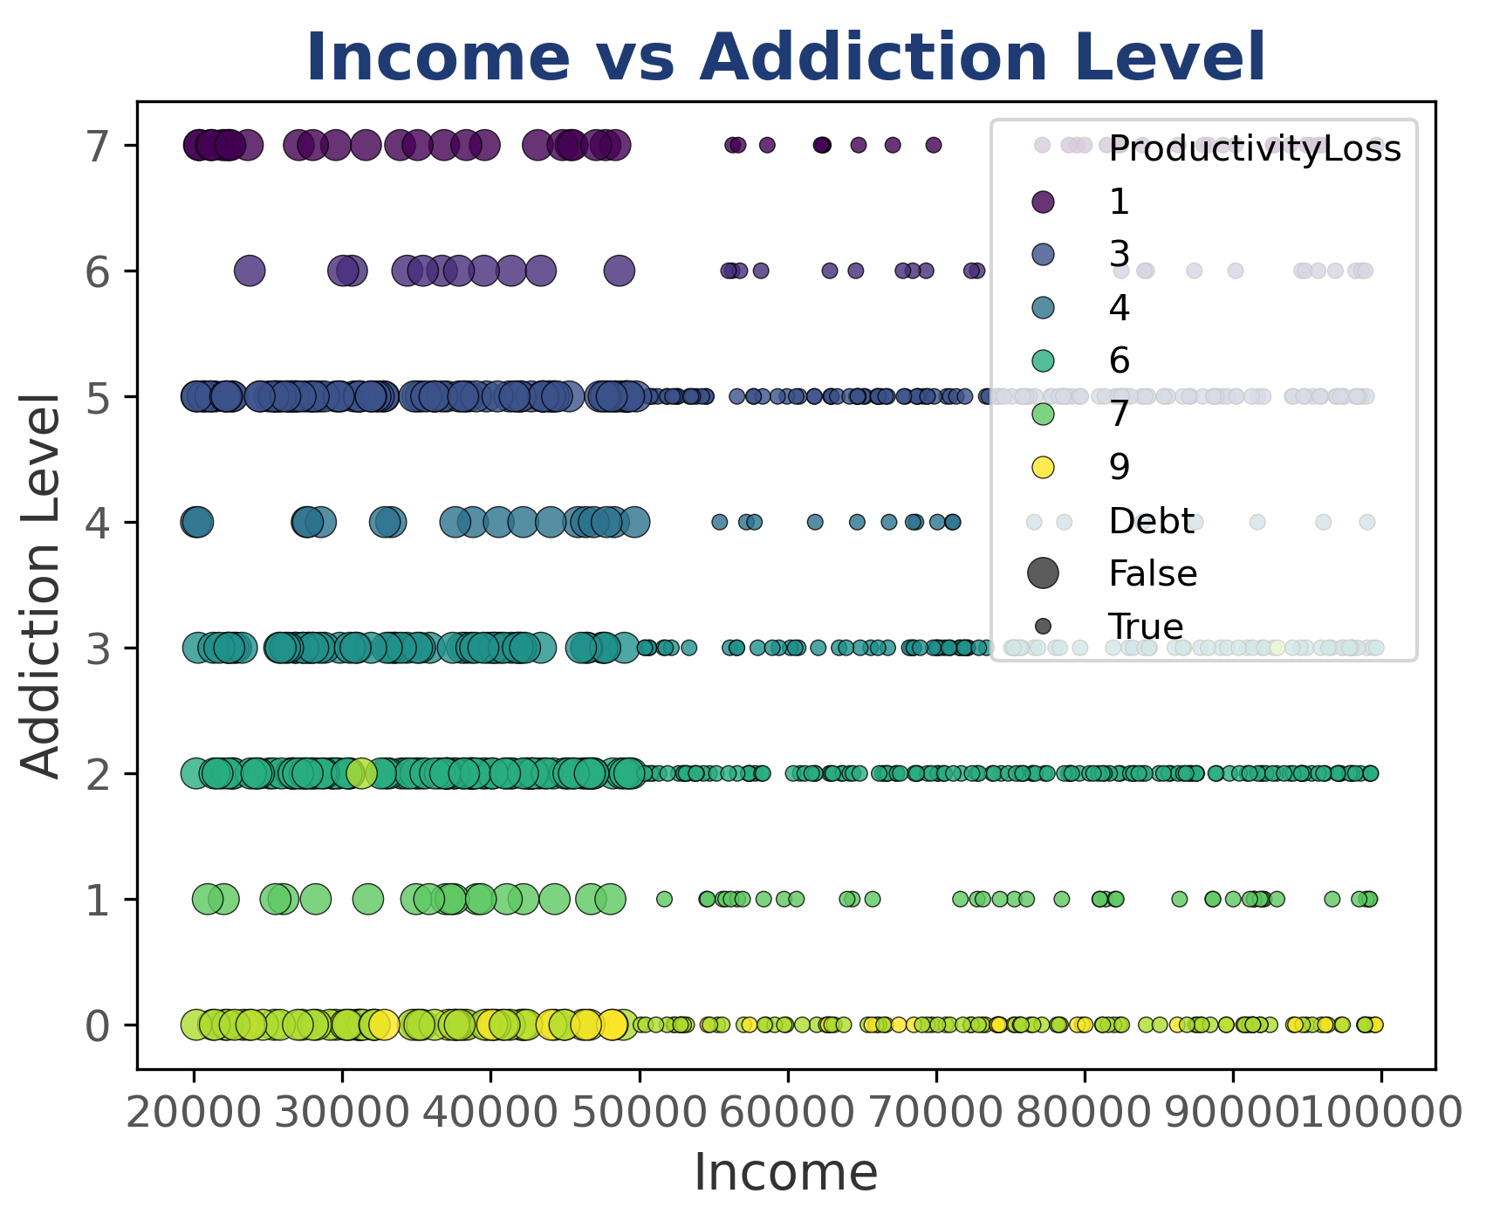
2. Demographic Influences
Age & gender → no major differences in time spent
Lower income → higher addiction, more debt, greater productivity loss
Higher income → lower addiction, less debt, better productivity
Insight: Socio-economic status, not age/gender, drives addictive usage

Slide 6
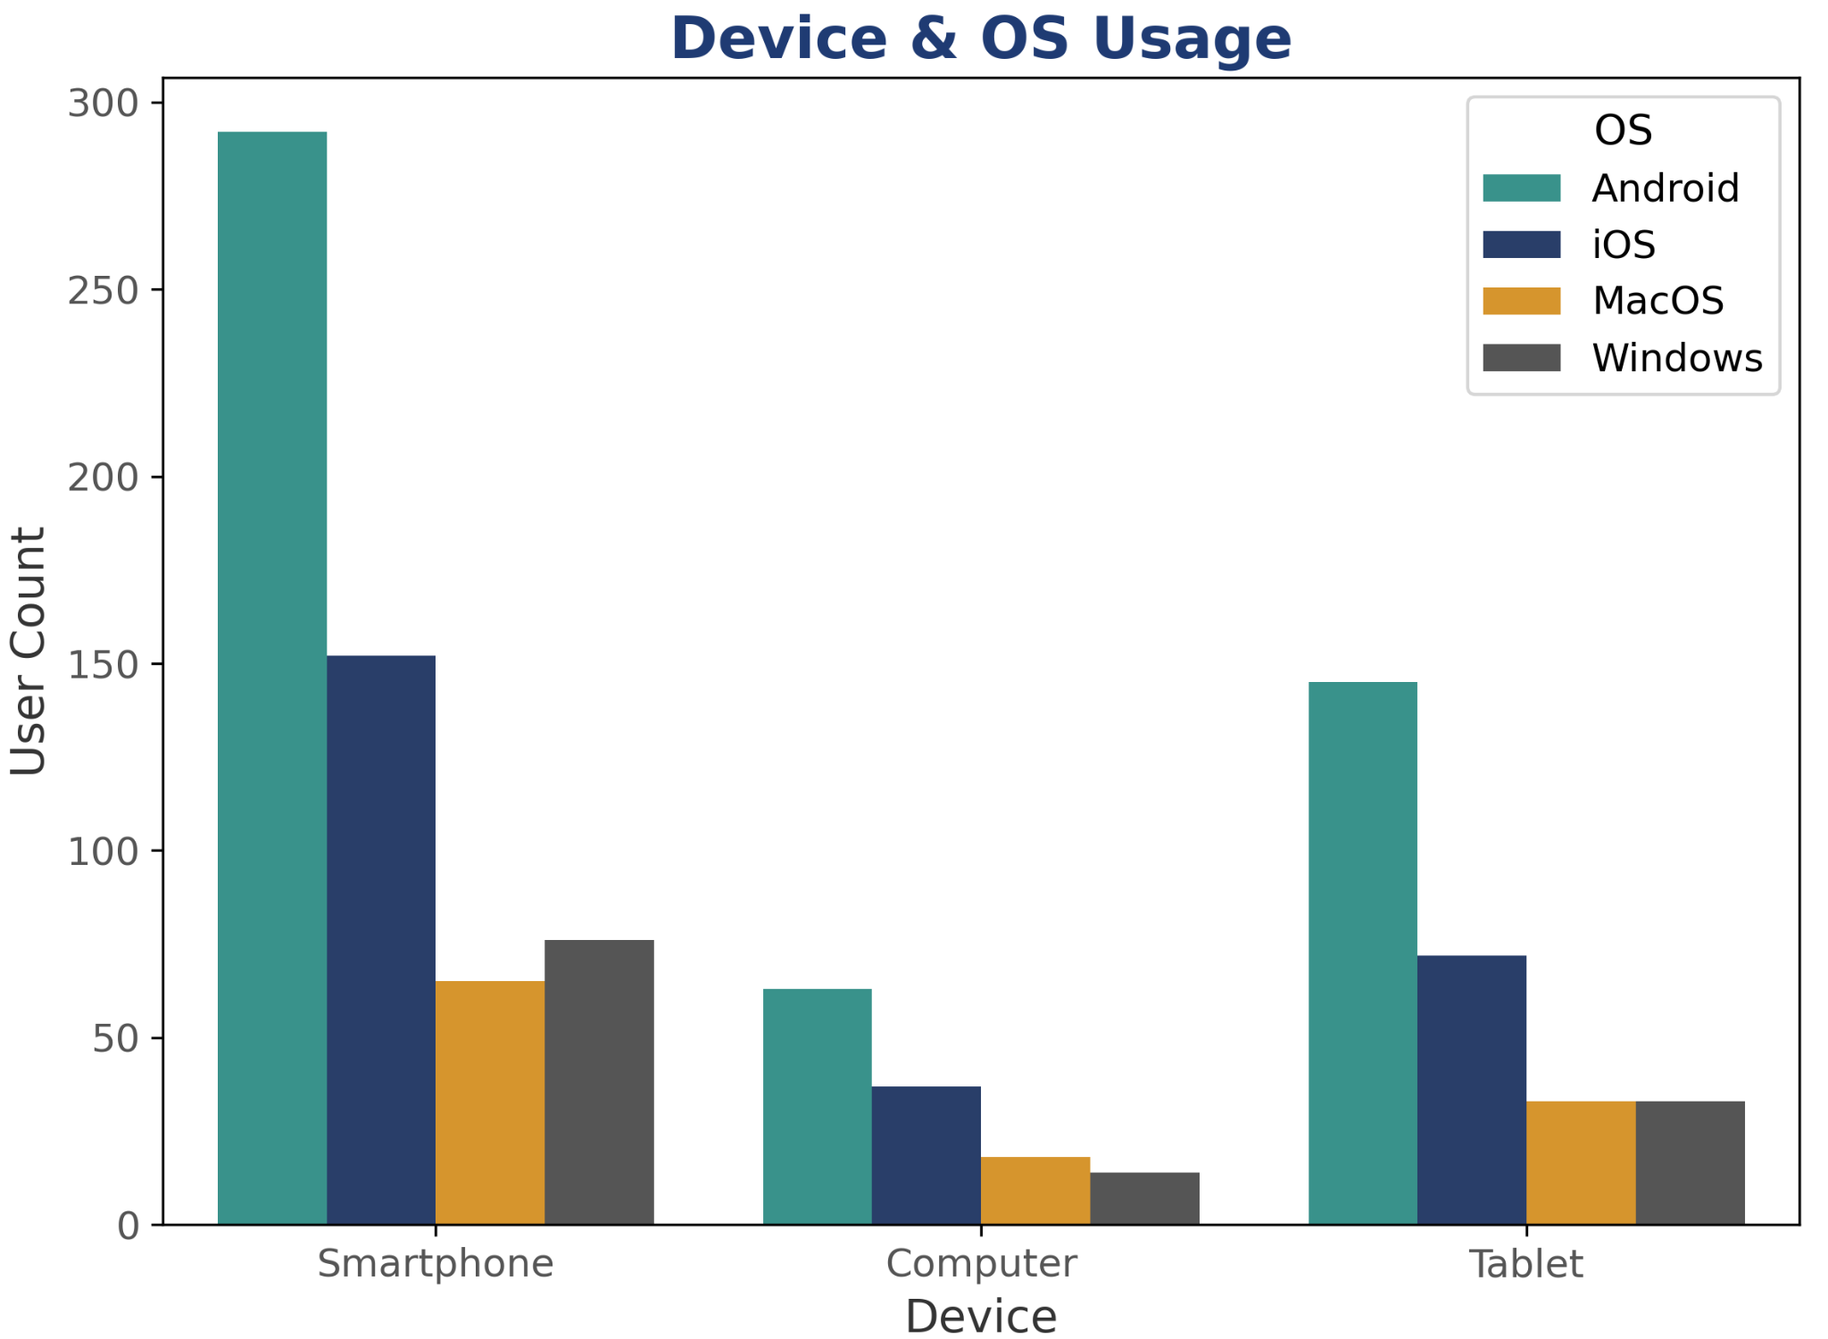
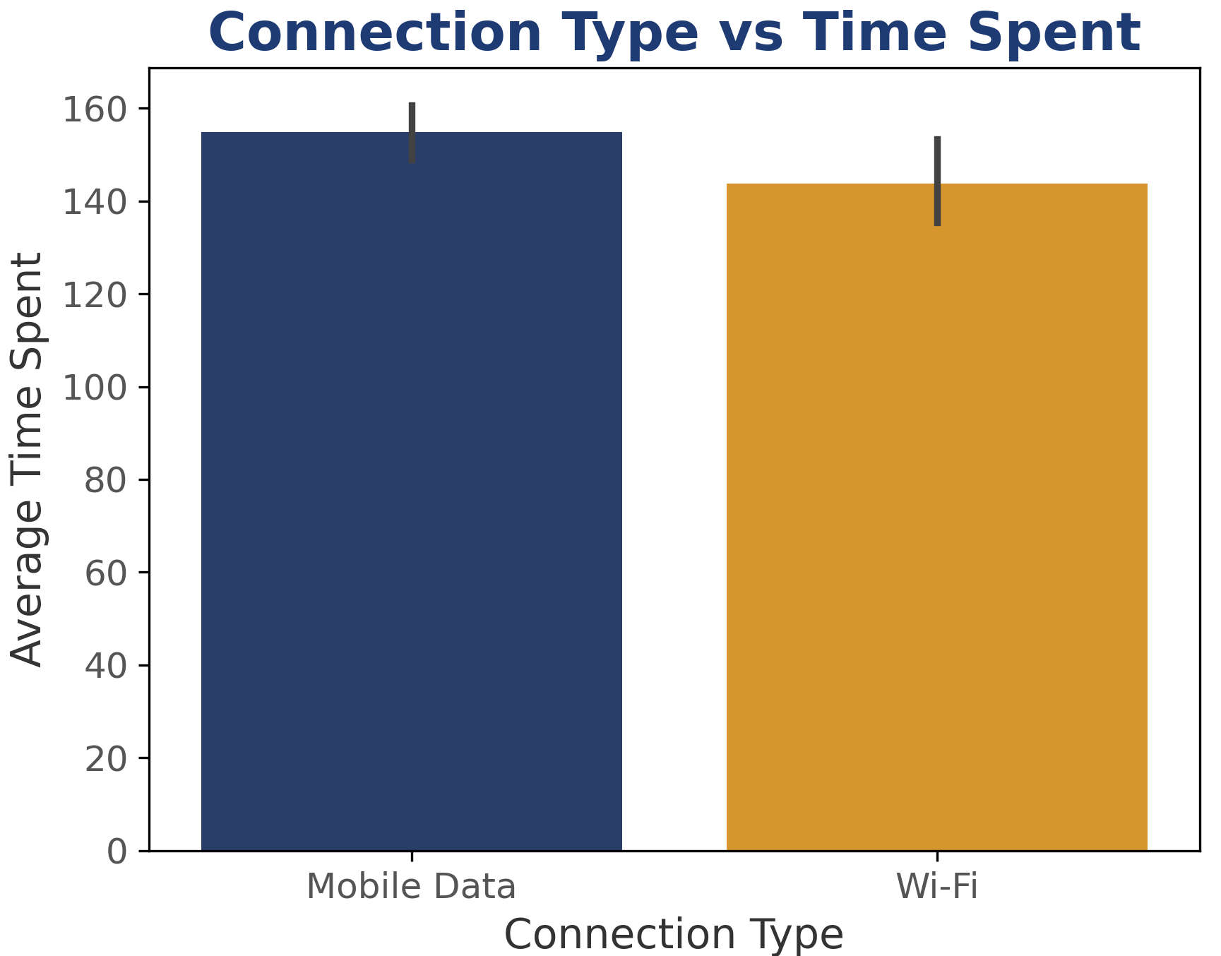
3. Device, OS & Connectivity Factors
Smartphones (esp. Android) most popular device
Time spent is similar across smartphones, computers, tablets
Mobile Data users spend slightly more time than Wi-Fi users
Insight: Device & connection type don’t change usage time much — smartphones simply make access easier

Slide 7
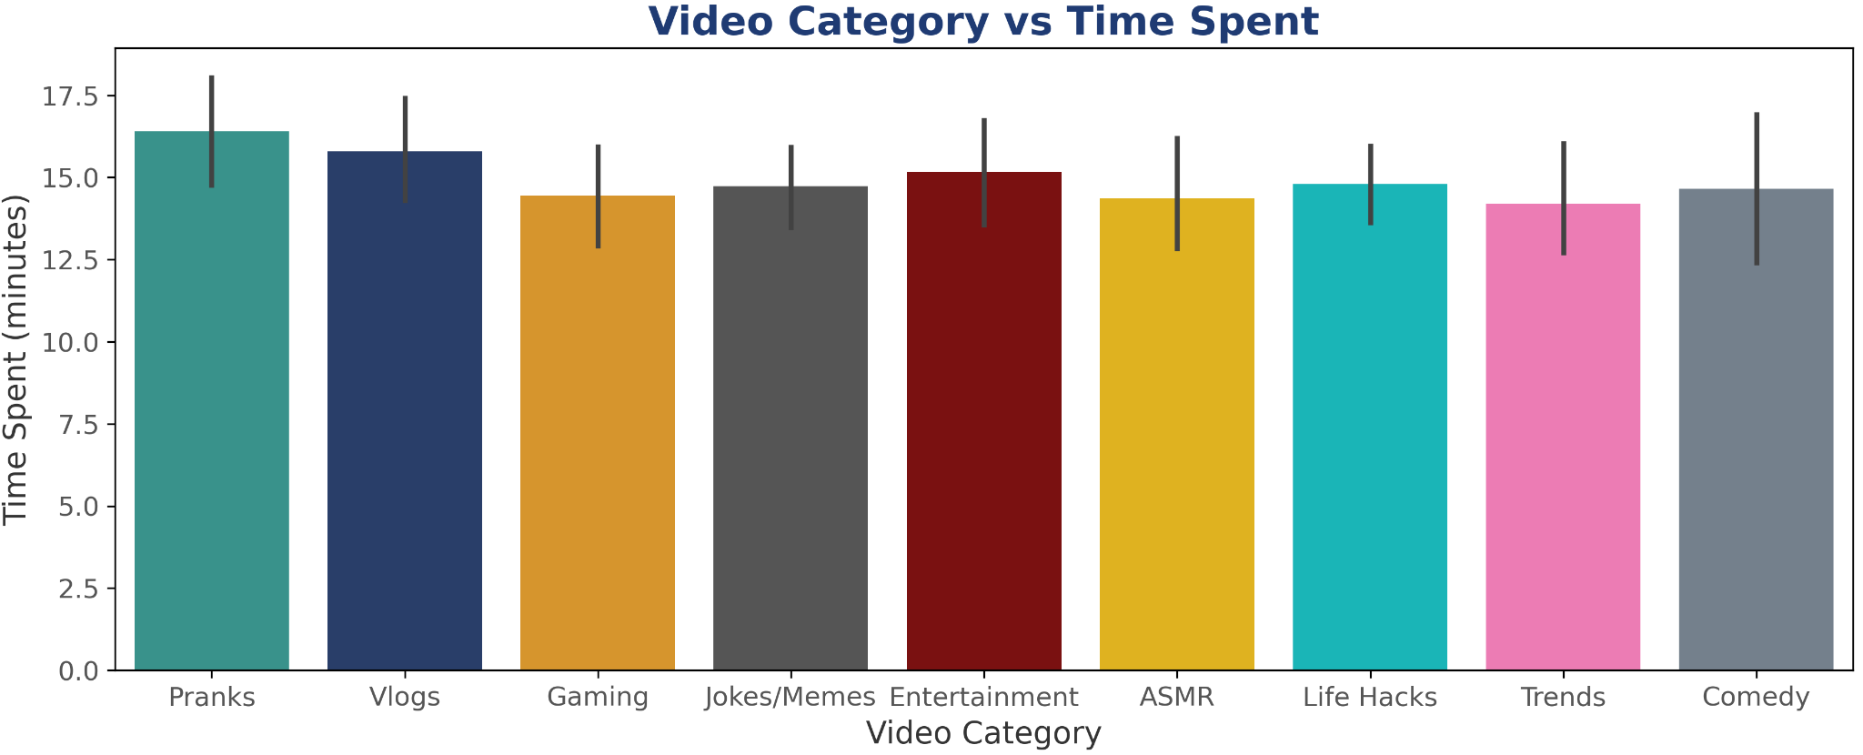
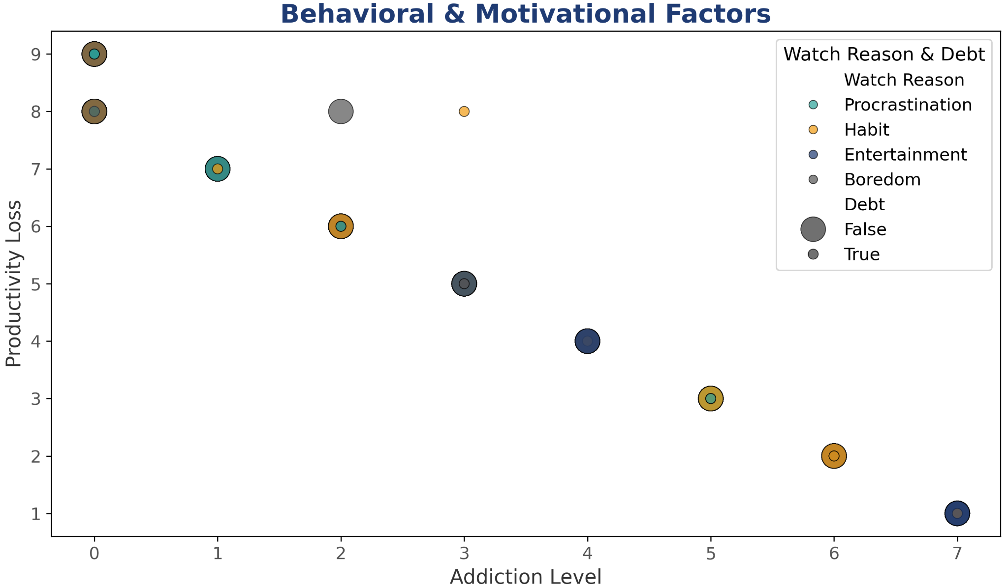
4. Content Engagement & Behavioral Impacts
Pranks & Vlogs → longest watch times (~16–17 mins); Trends lowest (~14 mins)
Entertainment-based content keeps users engaged longer than casual/trendy content
Higher addiction → lower productivity
Procrastination & habit → main motivators; entertainment dominates at higher addiction levels (linked to greatest productivity loss)
Debt appears more in mid–high addiction groups
Insight: Entertainment boosts engagement but fuels addiction, reduces productivity, and increases financial risk

Slide 8
Final Overall Insight
Key Insights:
Platform-Wise Usage: All major platforms contribute to time-wasting (Facebook 26%, Instagram 24%, YouTube & TikTok 25%).
Demographics: Age & gender → no major differences. Socio-economic status drives addiction and productivity loss.
Device & Connectivity: Smartphones enable constant access; device/connection type doesn’t change total usage.
Content & Behavior: Entertainment-heavy content → longer engagement, higher addiction, lower productivity, and more financial risk.
Closing Thought:
“It’s not just how much time people spend, but what they consume, why they watch, and how it affects habits. Motivation & behavior are key to reducing addiction and productivity loss.”

Slide 9
Recommendations ✅
For Individuals 👤
Use screen-time trackers & app limits
Avoid late-night scrolling; prefer set browsing windows
Choose quality/educational content over endless entertainment
For Organizations 🏢
Conduct digital well-being & productivity workshops
Train employees on procrastination & focus management
Educate on financial & mental impact of overuse
For Policymakers / Platforms 🌍
Add nudges, break reminders & healthy feed designs
Launch awareness campaigns for vulnerable groups
Promote digital wellness features (dashboards, screen-time reports)

Slide 10
Conclusion 📝
Social media time-wasting is driven by behavior, habits, and content, not age, gender, or device.
Addiction and productivity loss are strongly linked to income and debt levels.
Entertainment-heavy content boosts engagement but reinforces addiction and lowers productivity.
Actionable steps: Individuals track usage; organizations run well-being workshops; platforms add nudges and digital wellness tools.
Key takeaway: Reducing addiction requires shaping habits and mindful content consumption, not just limiting screen time.

Slide 11
Thank You

